Slide 1

Dual Enrollment
New Student Orientation at
Athens Technical College

Slide 2

Welcome to Athens Technical College Dual Enrollment!
Dual Enrollment (DE) Checklist - Next Steps for New Dual Students
Your acceptance letter was sent to you in the mail and included the DE checklist so you can complete all items.
  The checklist guides you through preparing for classes (ex: college technology, textbooks and supplies, funding, and registration for classes).
  Use the checklist each semester for registration and questions as well as contacting your ATC DE coordinator.

Slide 3

Who is My Dual Enrollment Coordinator?
Katie Huberty
High School Coordinator, (khuberty@athenstech.edu or 706-552-0903)
Serving Elbert, Madison, Morgan, Oconee, Oglethorpe, Taliaferro, and Washington Wilkes
Jannah Zinker
Career Academy Coordinator, (jzinker@athenstech.edu or 706-552-0985)
Serving Clarke, Greene, Hart, Social Circle, Walton, Out of Service Area Schools, and Home Schools

Slide 4
ATC Student ID Number
Visit the Athens Technical College (ATC) website at www.athenstech.edu.
Under “Admissions”, click on “Newly Accepted Students”.
Under “Get Your Student ID”, click on “Find Your ATC Student ID Number”.

Slide 5
Single Sign-On
ATC uses OKTA Verify to integrate logins for Banner Web, Blackboard, and your college ATC email applications.
Please set up your account now!
If you have trouble with your ATC account, please submit a support ticket at www.athenstech.edu. Under “Current Students”, click on “Student Resources”, and then click on “Email Support & Password Reset”.
Visit the Athens Technical College website.
Under “Admissions”, click on “Newly Accepted Students”.
Under “Set Up Your ATC Single Sign-On Account”, click on “Set Up Your Account”.

Slide 6

ATC Email Account
Your email address at Athens Technical College will be your first name, last name, and the last 3 digits of your student ID followed by @student.athenstech.edu.
    Example: johndoe123@student.athenstech.edu
  Please ensure that you have access to your ATC email account before classes begin.
You must check your ATC accounts daily, especially your ATC student email and Blackboard. Important information will be sent to you through your ATC student email account.
Information about dual enrollment registration, funding, balances, and messages from ATC instructors will be communicated to you through your ATC student email.
You will be responsible for the information sent to you.

Slide 7
Student ID, Parking Decals, and Textbooks/Access Codes
Student ID Card
  Visit the Student Activities Center at any ATC campus to obtain your Student ID card.
Parking Decals
  Visit the Office of Admissions front desk at any ATC campus to receive your parking decal.
  Display the parking decal in your vehicle to avoid parking violations.
Textbooks and Access Codes
  Visit the ATC Library to obtain your free textbooks and/or virtual textbook access codes.
  Textbooks and/or access codes can be picked up on the first day of class unless earlier pickup is arranged. You must have your student ID card to claim your textbooks and/or access codes.
  Do not buy textbooks or access codes for your DE classes as they are free for DE students.
  You must return physical textbooks to the library at the end of each semester, or you will be responsible for payment of the textbooks.
  Email libraryservices@athenstech.edu to arrange for early pickup or have your textbooks sent to the Elbert or Walton campus.

Slide 8

Orientation Assignments
You will need to complete two online assignments as a new Athens Technical College student.
  How to Access the Online E-Learning/Blackboard Orientation
      Visit the ATC website at www.athenstech.edu.
      Under “Admissions”, click on “Newly Accepted Students”.
      Under “Next Steps for New Students”, scroll down to where it reads, “Learn How to Use Blackboard”.
      Click on “View Online Learning Resources”. Once you have reviewed that page, click the back button and click on “Complete the Blackboard Orientation”.

Slide 9

Orientation Assignments Cont’d
You will need to complete two online assignments as a new Athens Technical College student.
  How to Access the Online New Student Orientation
      Visit the ATC website at www.athenstech.edu.
      Under “Admissions”, click on “Newly Accepted Students”.
      Under “Next Steps for New Students”, scroll down to the bottom of the page where it reads, “New Student Orientation”.
      Click on “Virtual New Student Orientation”.
  You must pass both assessments to receive credit for completion.

Slide 10
Advisement and Registration
Contact your ATC Dual Enrollment coordinator prior to registration to discuss what courses you wish to be enrolled in for the semester. Students cannot register themselves for classes.
  You must always include your high school counselor in this plan as these classes are for dual credit and are included in your high school and college transcripts.
The following information should be included in your communication to your DE coordinator:
    Your official full name
    Your ATC college ID number
    The subject of the course (ex: ENGL 1101)
    The five-digit CRN (course registration number) of the course (ex: 20123)
To confirm your registration, use your Banner Web account and review your class schedule. Make a note of the start and end dates of your courses, as well as the location and meeting times. Reach out to your ATC DE coordinator immediately if you have any questions or concerns.
  You must send your ATC class schedule to your high school counselor each semester so they can approve your courses for payment.

Slide 11


What Will My Class Schedule Look Like?
You get to choose!
Choose your college courses to accommodate your high school schedule.
    Part-time or full-time
      3 to 15 credit hours
    Morning, afternoon, or evening courses
      Monday (M)/Wednesday (W)
      Tuesday (T)/Thursday (R)
      Friday (F)
      Online
  ATC’s campuses are located in:
    Athens, Elbert, and Walton
    Ask your high school counselor if any DE courses are being taught at your high school so you will not have to drive to a college campus.

Slide 12


Attendance and Exams
Students are expected to attend class as scheduled.
  Make up and late work may not be accepted. It is up to the discretion of the instructor, and their decision will be final.
All college courses have assignments and exam due dates which must be adhered to.
  These dates are outlined in the course syllabus. Contact your instructor if you have any questions.
Mid-term and final exams must be taken during the weeks designated by the college at the location outlined in the course syllabus.
Online classes will have proctored mid-term and final exams on the college campus.
Taking your final in person could mean you may miss a class at your high school, so you must make arrangements with your high school counselor because college exams are required and should be excused absences.

Slide 13

No-Show Reporting
No Shows are reported for nonattendance in the first week of the semester.
Any student who fails to attend class or log in and complete an academic activity for classes within the first seven days of the semester will be reported as a No Show.
No Show classes will not appear on a student’s record at ATC.
Course Cancellations
In the event of class cancellation or school closure due to severe weather or other emergencies, students are expected to continue participating in learning activities via Blackboard, their official college email account, or other modality. Instructors will provide information on their continuation of instruction plans in their syllabus.

Slide 14
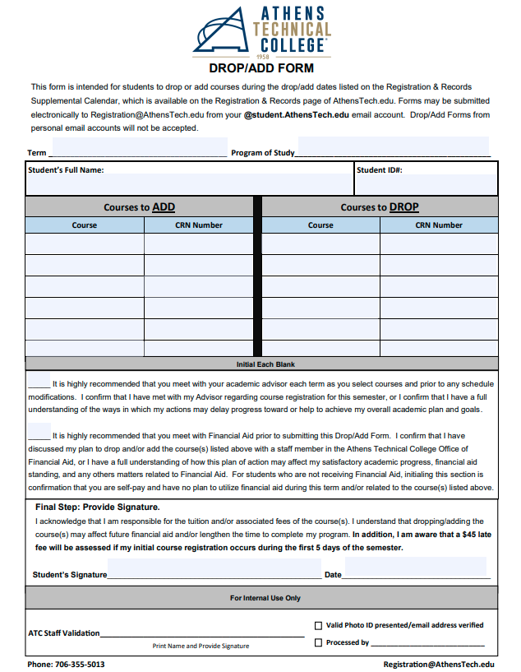
Drop/Add at ATC
Drop/Add is scheduled on the first three days of each academic semester.
Students needing to make changes to their schedules must do so by the third day of the semester (not the third meeting of their class).
Students may drop or add courses during this period by emailing their ATC DE coordinator and completing the ATC Drop/Add form.
  Students may access the Drop/Add form by visiting www.athenstech.edu. Under “Current Students”, click on “Registration & Records”, scroll down to the “Forms” section, and click on “Drop/Add Form.”
  Courses dropped during Drop/Add will not appear on the students’ official ATC academic record.

Slide 15
Withdrawals at ATC
Students will be assigned a grade of "W" for those course(s) if the requested information is received by the withdrawal deadline date of the semester.
All withdrawals must be approved by the high school counselor to ensure the student stays on track to graduate from high school.
While a grade of "W" does not count in the student's cumulative grade point average at ATC, it does count in attempted hours for financial aid purposes and could affect a student's eligibility for aid at ATC.
Students who stop attending classes without formally withdrawing from their classes risk earning a final grade of “F” for their classes which will appear on their academic transcripts.
DE students are allowed 2 withdrawals. After withdrawing from a second course, students are no longer eligible to receive DE funding.
Withdrawals must be submitted, via the Withdrawal Form, to the ATC DE coordinator before the withdrawal deadline each semester.
Students may access the Withdrawal Form by visiting www.athenstech.edu. Under “Current Students”, click on “Registration & Records”, scroll down to the “Forms” section, and click on “Withdrawal Form .”
Withdrawing or failing courses can negatively affect your academic standing with Athens Technical College and also your eligibility to receive Dual Enrollment, ACE Grant, HOPE Grant, and/or HOPE Career Grant funds by not maintaining satisfactory academic progress (SAP).

Slide 16

Classroom Behavior Expectations
Students enrolled in college classes, whether they are physically taking the class on a college campus site or at a high school/career academy site, should abide by their instructor’s classroom policies and the following guidelines while in the classroom:
  Mute cell phones and put them in a backpack or purse. Students should not be using a cell phone during class time.
  Do not work on other class assignments or talk with classmates during class time unless the instructor has given permission.
  Participate in in-class work, group work, projects, or class discussion.
Disruptive behavior that inhibits instruction or learning in the classroom can result in a code of conduct violation.

Slide 17
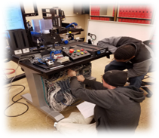

Student Conduct
In order to provide an environment conducive to learning, ATC has established regulations and obligations to govern conduct.
Students are expected to exercise mature and responsible self-discipline, to behave with courtesy and integrity, and to maintain appropriate conduct standards.
Students who violates any part of the student conduct code shall be subject to disciplinary procedures including dismissal from a class session by the instructor or suspension or expulsion from ATC by the authorized administrator.
  Behaviors that may result in this type of action include, but are not limited to:
    Academic dishonesty, including but not limited to cheating, plagiarism, and collusion.
    Forgery, alteration, or misuse of college documents or records.
    Falsifying information with the intent to deceive.
    Theft or property damage.
    Disrupting the educational process.
    Violating federal, state, or local law.

Slide 18
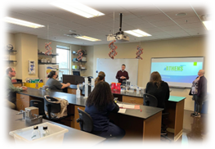
Academic Integrity
ATC requires an academic culture of honesty and personal integrity among its faculty, staff, and student body.
Academic honesty means performing all academic work without plagiarizing, cheating, lying, tampering, stealing, receiving assistance from any other person or using any source of information that is not common knowledge (unless authorized by the instructor).
Prohibited behaviors include, but are not limited to the following:
  Plagiarizing any assignment.
  Copying/submitting another person’s work.
  Unauthorized taking of someone else’s work.
  Using unauthorized notes or equipment (including programmable calculators or smart phones) during an examination.
  Stealing an examination or using a stolen examination.
  Allowing another student to have access to your work, thereby enabling that student to represent the work as his or her own.
  Having someone else take an assessment in your place.
  Fabricating information such as data for a lab report.
  Using another person’s personal electronic file or copying another student’s computer program.
Depending on the severity of the situation, any student found to be in violation of any of the listed prohibitions will be subject to a range of disciplinary actions, which may include the following:
  A zero for the assignment.
  An F for the course.
  Dismissal from the program.
  Dismissal from the College.

Slide 19


Student Support Services
If you need accommodations, you must contact ATC’s Student Success Center (see the contact information below):
Athens Campus, K-614E
706-355-5010
disabilityservices@athenstech.edu
Students will need to provide documentation from a qualified healthcare professional to secure accommodations. Documentation must be current and compliant with the Technical College System of Georgia (TCSG) requirements.
Note: Some of the accommodations which are approved at the secondary school level may be deemed unreasonable by the Accessibility Services program at the post-secondary level.
Other resources are available through the Student Success Center such as career services, counseling, free tutoring, and more!

Slide 20
Financial Aid for DE Students
The Dual Enrollment funding application must be completed every academic year via your GAfutures account (www.GAfutures.org).
The application is good for the summer, fall, and spring semesters, and pays for a maximum of 30 semester hours.
  As the student, you must complete the DE funding application prior to being registered for your classes.
  The application must be completed by you and approved by your parent/guardian.
    You will be responsible for payment if this step is not completed each academic year.
  Your high school counselor and ATC will approve your individual classes every semester so that your classes will be covered by DE funding.
  DE funding covers your tuition, mandatory fees, and textbooks. DE funding does not cover course supplies or fees.
  Male students who are at least 18 years of age must register for the Selective Service System to receive DE funding. If this applies to you, please visit www.sss.gov to register, and send your registration number to dualenrollment@athenstech.edu so your ATC DE coordinator can receive it.
Alternative funding is available and eligible DE students can receive HOPE Grant, HOPE Career Grant, or Accelerated Career Education (ACE) grant funding. Please contact your ATC DE coordinator for more information.
Notes:
Home school students must have their parent/counselor complete the funding application to receive funding. Refer to the Home Study section on the GAfutures website for instructions.
Funding cap: 15 total credit hours per semester and 30 total credit hours are paid for by the DE program.
Eligibility: Two maximum withdrawals are allowed (grades of “W”). After that, DE students are no longer eligible for DE funding.
Students must self-pay for all tuition and fees not covered by the DE program. Students are only allowed 30 semester hours through the Dual Enrollment program.
Students who desire to complete an Accelerated Career Program will use the ACE Grant to pay for tuition and fees. Students must complete the GSFAPP and provide proof of lawful presence and Georgia residency to be eligible for this funding.
Students who choose a program in a high demand field of study may be eligible for the HOPE Grant and HOPE Career Grant as an additional funding source once they reach the 30 semester hours allowed in dual enrollment. Contact your ATC Dual Enrollment contact to see if you qualify. If you do, you must also complete the GSFAPP and provide proof of lawful presence and Georgia residency to be eligible for this funding.

Slide 21
GAFutures
Dual Enrollment covers up to 30 semester hours, total. It is limited to 15 hours a semester. This funding cap is across all collegiate institutions.
Funding applications must be completed by the student and the parent every year, beginning in the summer term.
Funding covers tuition and mandatory fees.
Textbooks are loaned, free of charge by the college through the library, but must be returned at the end of each semester.
Funding does not cover supplies or fees specific to a program.
Students will still be eligible for full HOPE Scholarship after graduation.

Slide 22
Applying for Funding
Visit www.GAfutures.org.
Select the Sign In option at the top of the GAFutures homepage or select Create an Account.
Enter your Username and Password information; then select Sign In.
At the top of the page, select HOPE & State Aid Programs.
Next, select State Scholarships and Grants. The Dual Enrollment tab should appear.
Next, scroll down, and on the left-hand side, click on Application Procedures and Deadline.
On the right-hand side, select the blue “Apply Now” button.

Slide 23
ACE Grant
ACE Grant is available to students who are completing the Accelerated Career Program and in good academic standing.
  Must be completing
    2 published TCCs,
    A published Program Leading to Licensure,
    Any Technical College Diploma, OR
    Any Associate Degree of Applied Science.
  Students must attend a public high school to be eligible.

Slide 24
ACE Grant Application
Visit www.GAfutures.org.
Select the Sign In option at the top of the GAFutures homepage or select Create an Account.
Enter your Username and Password information; then select Sign In.
At the top of the page, select HOPE & State Aid Programs.
Next, select State Scholarships and Grants. The Dual Enrollment tab should appear.
Next, scroll down, and on the left-hand side, click on GSFAPP application.
On the right-hand side, select the blue “Apply Now” button.

Slide 25
Using HOPE Career Grant
Students can use HOPE Grant/HOPE Career Grant after running out of funding if they are in an eligible program.
Students will have to pay out of pocket for books associated with classes.
This will use some of the HOPE Scholarship funding students get access to after graduation.

Slide 26
Satisfactory Academic Progress
At ATC, the satisfactory progress policy includes both a qualitative measure (cumulative GPA) and a quantitative measure (maximum time frame). Failure to maintain satisfactory academic progress (SAP) will result in the loss of all financial aid.
  Qualitative: Students must maintain a cumulative grade point average (GPA) of at least 2.0. The GPA is computed by ATC’s Office of Registration & Records on a scale of 4.0.
  Quantitative: Students must successfully complete two-thirds (66.6%) of all hours attempted.
Failure to maintain SAP will result in the loss of funding. The SAP policy applies to all students, regardless of whether they have previously received aid.
  Financial aid regulations consider new students and transfer students to be making satisfactory academic progress.
Successful grades include A, B, C, and D. Unsuccessful grades include F, I, IP, W.
Students must also show a completion rate that will allow the student to complete a program of study in at least 150% of the time it should require (as determined by the college catalog). For example, a student in a program requiring a total of 98 semester credit hours will receive financial aid up to 147 semester credit hours for that program. Transfer credits accepted by ATC as earned hours will be counted in the maximum timeframe.

Slide 27
Satisfactory Academic Progress Cont’d
Warning: Students who do not meet SAP will initially be placed on Financial Aid Warning. A student assigned a Warning will be notified by email at their ATC student email account. The student may continue to receive financial aid for one subsequent semester under this status. SAP standards must be met to continue eligibility.
Exclusion: Students who do not meet SAP standards under the Warning status at the end of the subsequent semester will be placed on Financial Aid Exclusion. Students on Exclusion are not eligible to receive financial aid.
Probation: Students who were placed on Financial Aid Exclusion may choose to appeal the exclusion. If the appeal is approved, the student is placed on Financial Aid Probation status. A student on Financial Aid Probation may receive financial aid for one subsequent semester. A student on Financial Aid Probation may be placed on an Academic Plan that will require the student to meet certain terms and conditions as determined by the Financial Aid Appeal Committee. At the conclusion of the Financial Aid Probation semester, the student must be meeting SAP standards or be meeting the requirements specified in the Academic Plan.
Appeals: Students placed on Financial Aid Exclusion may appeal the denial of financial aid if extenuating circumstances are present. A Request for Appeal of Financial Aid Exclusion form must be submitted explaining the extenuating circumstances, how these circumstances have changed, and their plan to maintain satisfactory academic progress if the appeal is approved. Supporting documentation is required. Appeals must be submitted to the Financial Aid Office prior to the midpoint of the semester for which students are appealing their exclusion status. Financial aid appeals are reviewed by a committee of faculty and staff. The committee's decision is final.
A dual enrolled student on Financial Aid Exclusion cannot be enrolled while waiting for the appeal results unless they pay tuition and fees out of pocket for the semester they are on exclusion. The semester will continue to be evaluated for SAP.

Slide 28
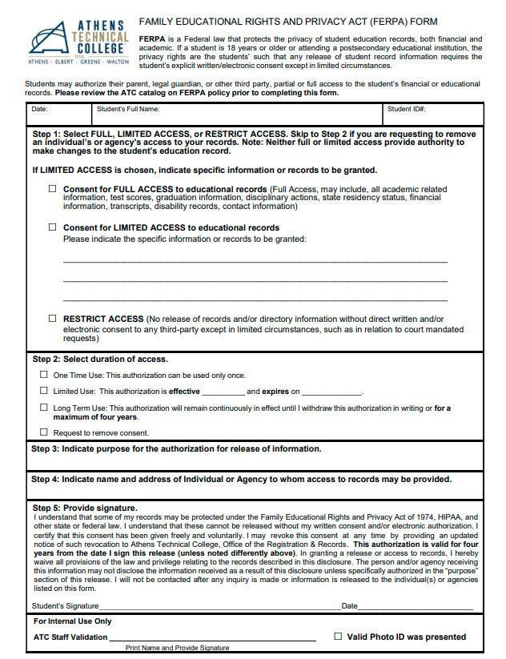
Family Educational Rights and Privacy Act (FERPA)
FERPA is a Federal law that protects the privacy of student education records, both financial and academic.
If a student is 18 years or older or attending a postsecondary educational institution, the privacy rights are the students’ such that any release of student record information requires the student’s explicit written/electronic consent except in limited circumstances.
Students may authorize their parent, legal guardian, or other third party, partial or full access to the student’s financial or educational records by completing the FERPA form.

Slide 29


Thank You for Your Time!
Questions? Please Contact the ATC DE Department
Email:
dualenrollment@athenstech.edu
Website:
www.athenstech.edu/dualenrollment

